Slide 1

Care Team Redesign for Value-based Care

Slide 2






Who we are
Quick Facts:
Shareholders: 28 primary care clinics
Dept of Medicine: 110 5 urgent care clinics
Dept of Primary Care: 108 13 dialysis units
Dept of Surgery: 65 6 ASCs and OBLs
Established in 1963 by 10 physicians
Now one of the largest physician-owned multi-specialty clinics in Southeast U.S.
306 physicians
206 advanced practice providers
40 specialties
74 locations in 17 counties
Over 2,500 employees
Market of approximately 725,000 patients
Over 815,000 outpatient visits in 2024, excluding dialysis
Over 32,000 outpatient surgeries/procedures in 2024

Slide 3


Slide 4
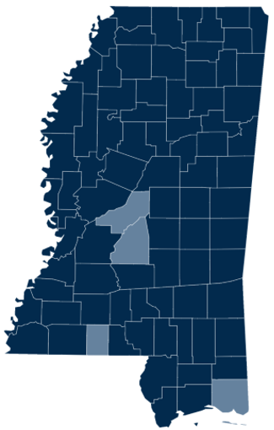


Slide 5
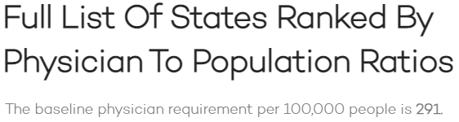
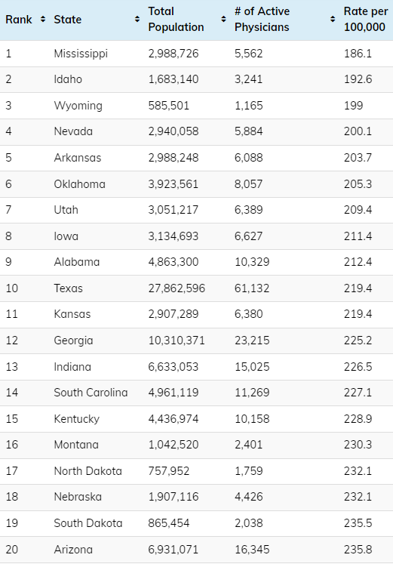
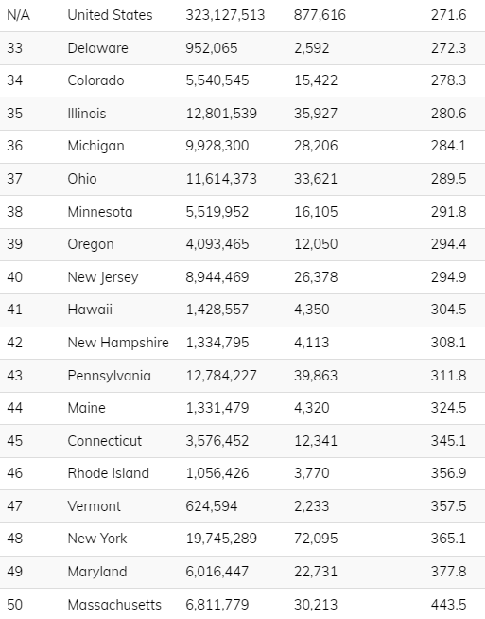
Data from 2018
nomadhealth.com

Slide 6
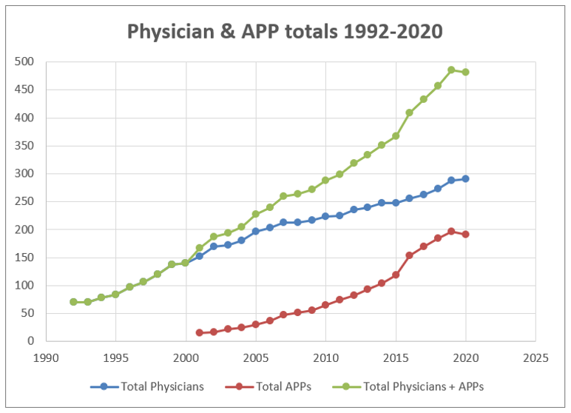
Hattiesburg Clinic medial staff data

Slide 7
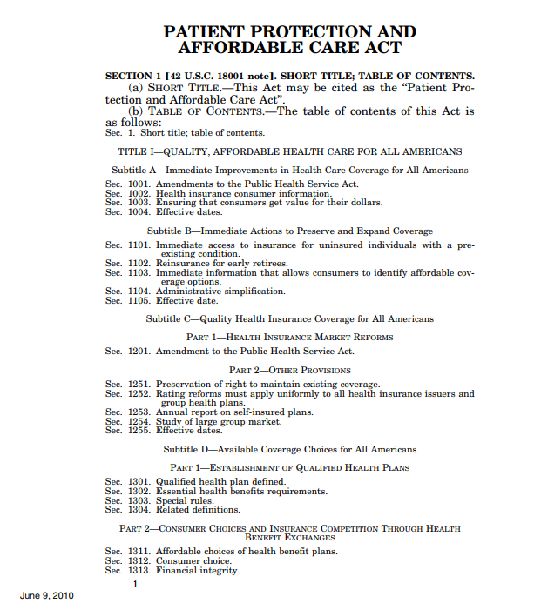
Congressional Establishment of the Medicare ACO Program
Section 3022 of the Affordable Care Act amended Section 1899 of the Social Security Act and established the Shared Savings Program on June 9, 2010.

Slide 8
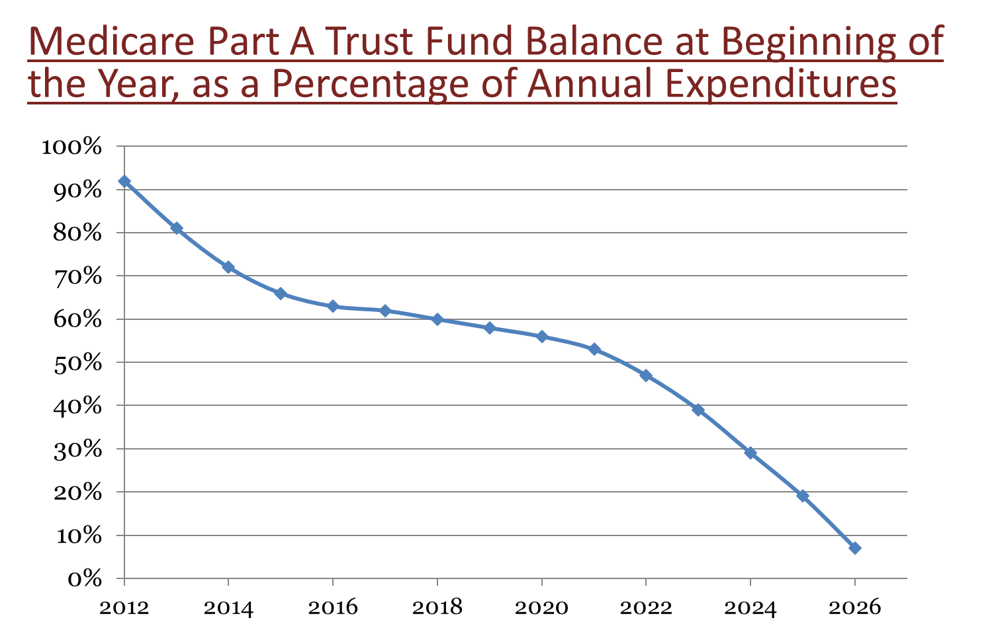
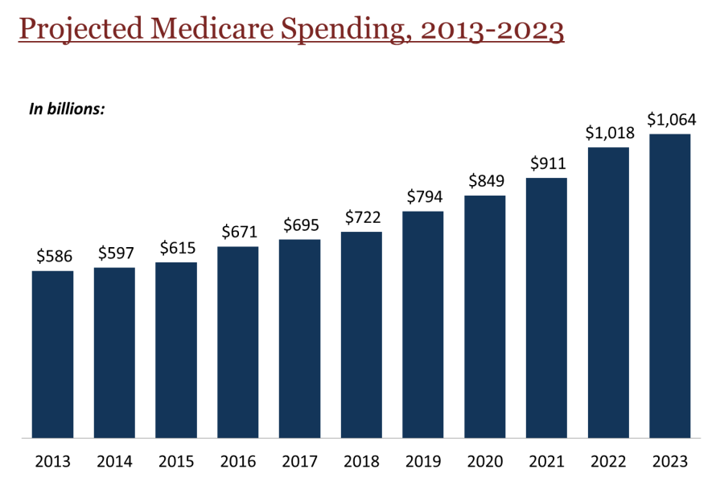
Traditional Fee-For-Service Healthcare Delivery

Slide 9

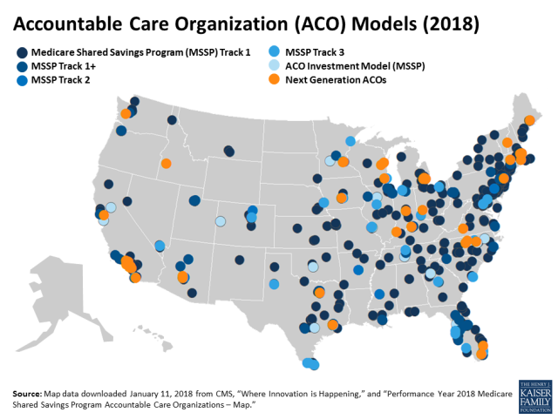
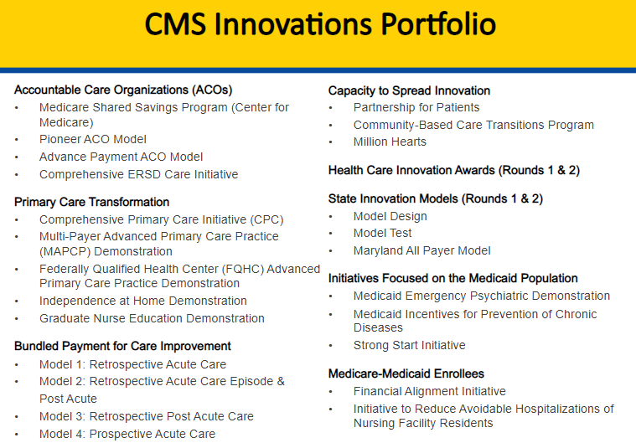
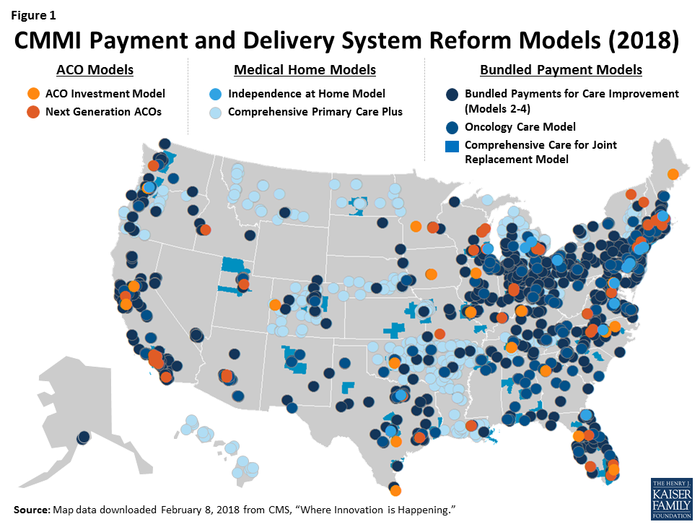

Slide 10
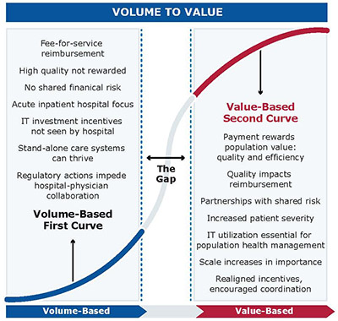

Journey to Value-based Healthcare Delivery

Slide 11
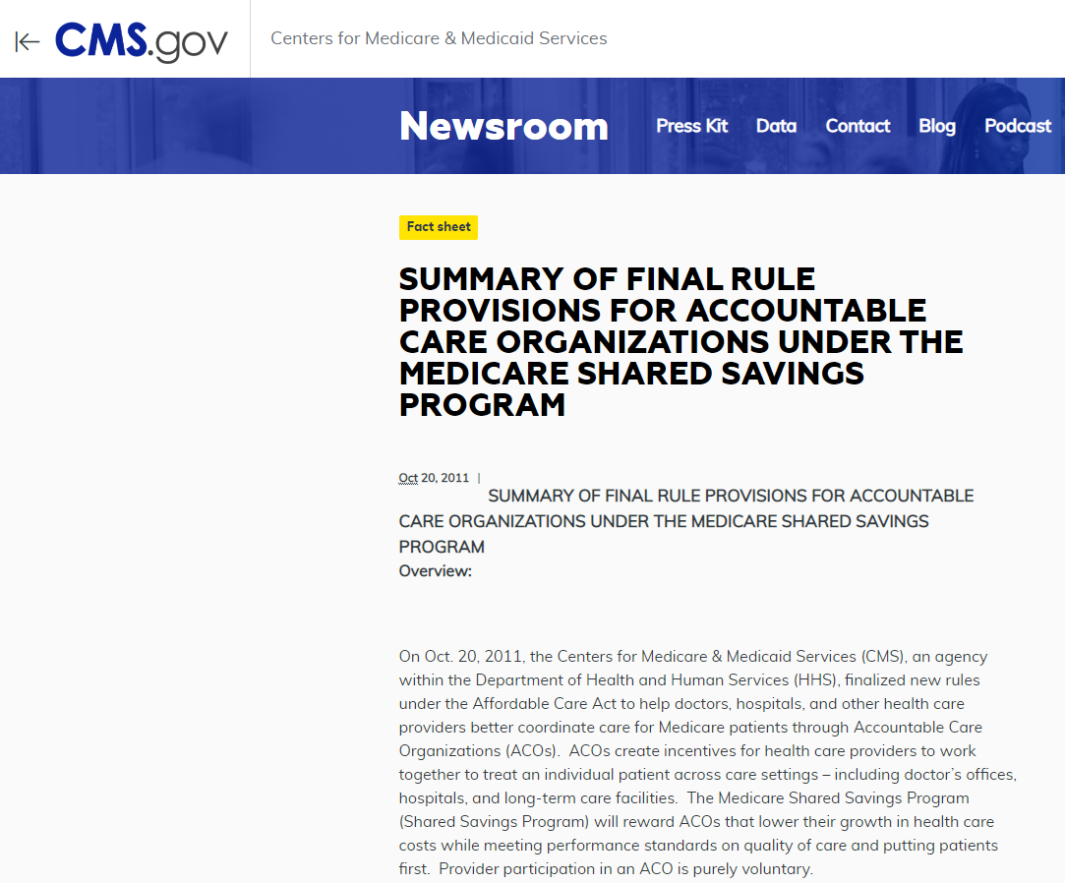
“The Medicare Shared Savings Program (Shared Savings Program) will reward ACOs that lower their growth in health care costs while meeting performance standards on quality of care and putting patients first.”
https://www.cms.gov/newsroom/fact-sheets/summary-final-rule-provisions-accountable-care-organizations-under-medicare-shared-savings-program

Slide 12
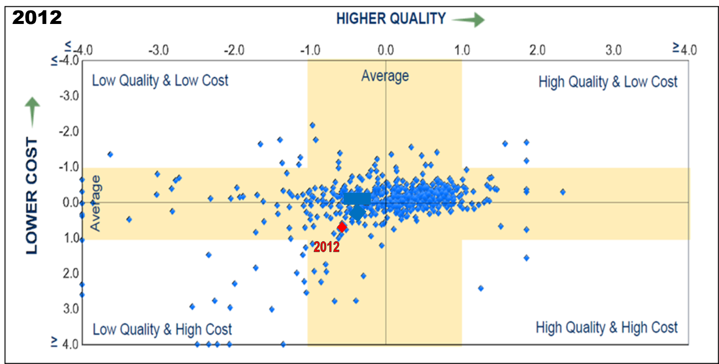

Hattiesburg Clinic’s CMS GPRO Data

Slide 13
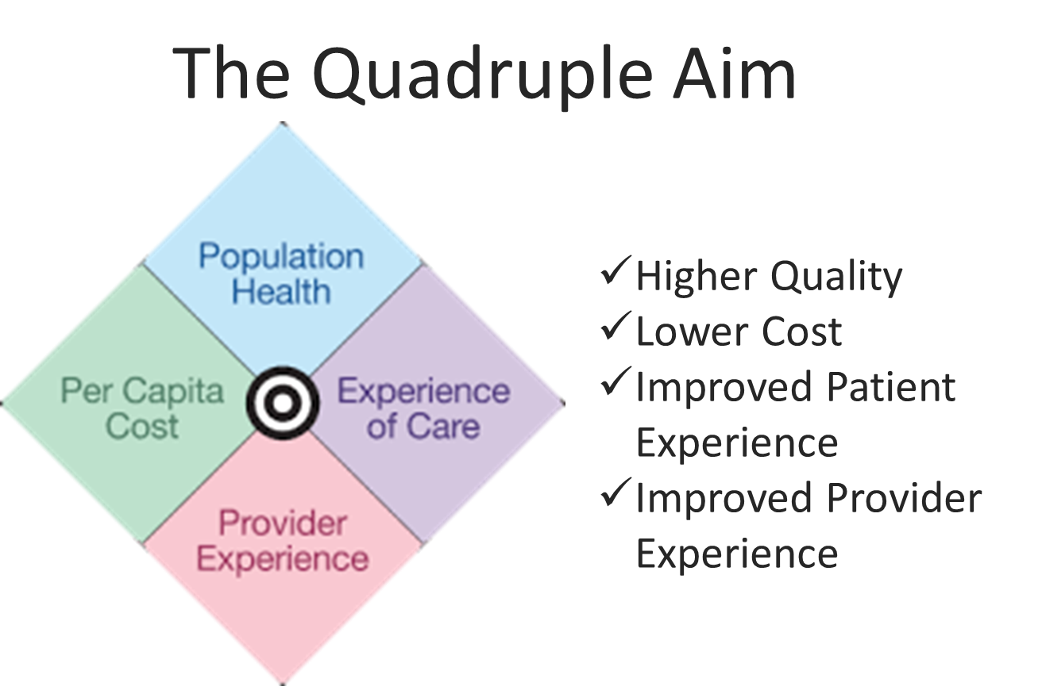
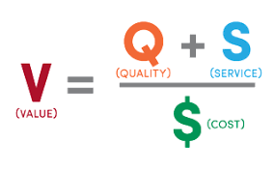
VALUE-BASED Healthcare Delivery

Slide 14

Hattiesburg Clinic Medicare ACO
(Accountable Care Organization)
Initial contract with Medicare effective 1/1/16
Track 1 Shared Savings Program (MSSP)
Initial attribution 14,559 patients
Hattiesburg Clinic Medicare ACO Patient Distribution by County

Slide 16
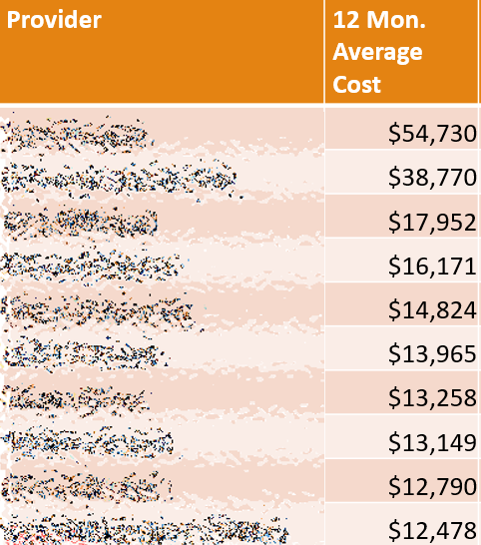
Original CMS Benchmark $9,947 PMPY
Lightbeam 2015 $10,536
Lightbeam 2016 (Jan – Mar) $10,056

Slide 17


Slide 18

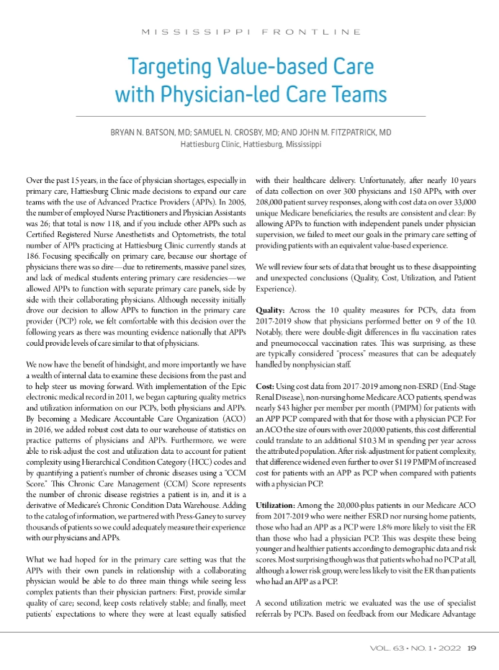
Importance of Physician-led Care Team
Claims, quality, and patient survey data from 2017-2019 Medicare ACO
Over 33,000 unique beneficiaries (non-ESRD, non-institutionalized)
Over 200,000 patient survey responses from Press Ganey

Slide 19
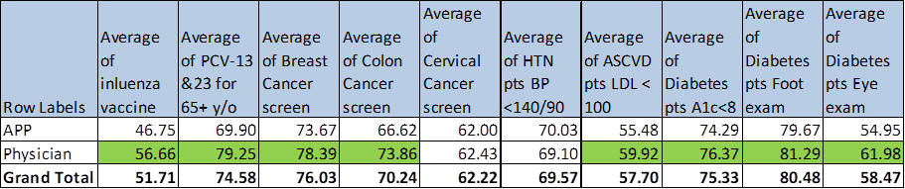
Quality:

Slide 20
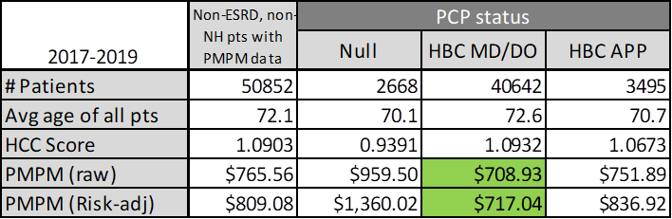
Cost:

Slide 21
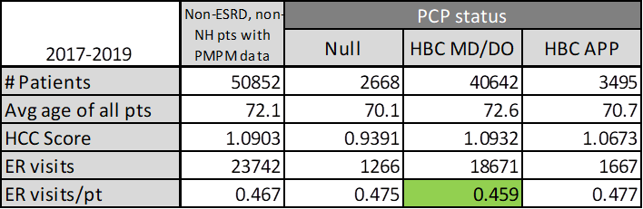
Utilization - ER:

Slide 22
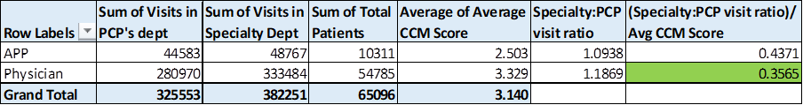
Utilization – Specialists:

Slide 23
Patient Experience:

Slide 24
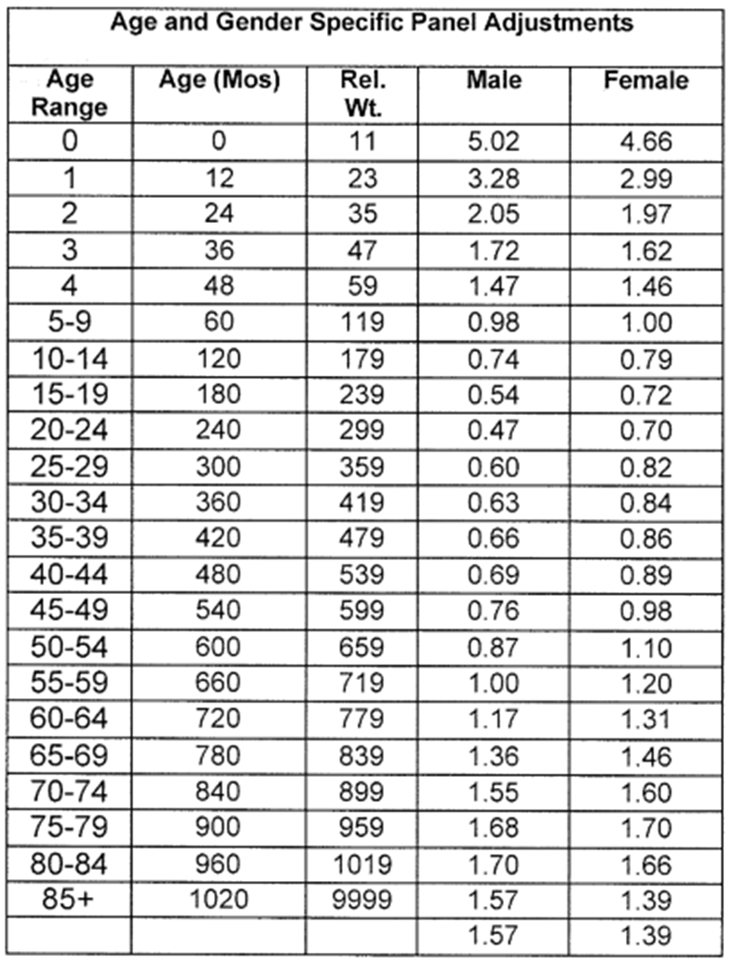
Primary Care team redesign:
Physician as PCP
Team-based care
Right-size panels

Slide 25


Slide 26



Slide 27
Hattiesburg Clinic’s CMS GPRO Data

Slide 28
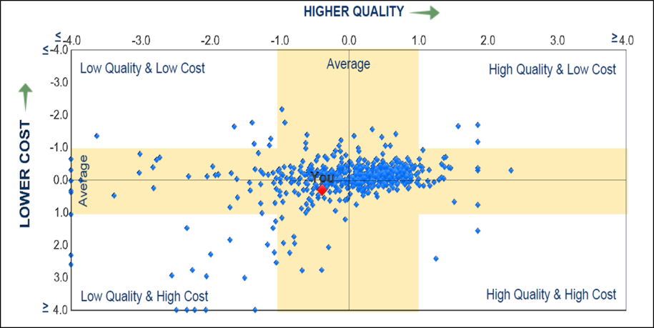
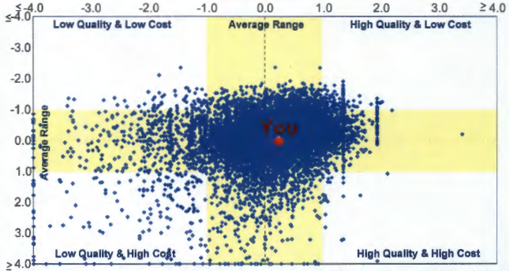
Hattiesburg Clinic’s CMS GPRO Data
2018
2017
2016
2013
2013
2015
2012
2012

Slide 29


ACO
Quality Rankings

Slide 30
Hattiesburg Clinic
Medicare ACO Financial and Quality Performance

Slide 31
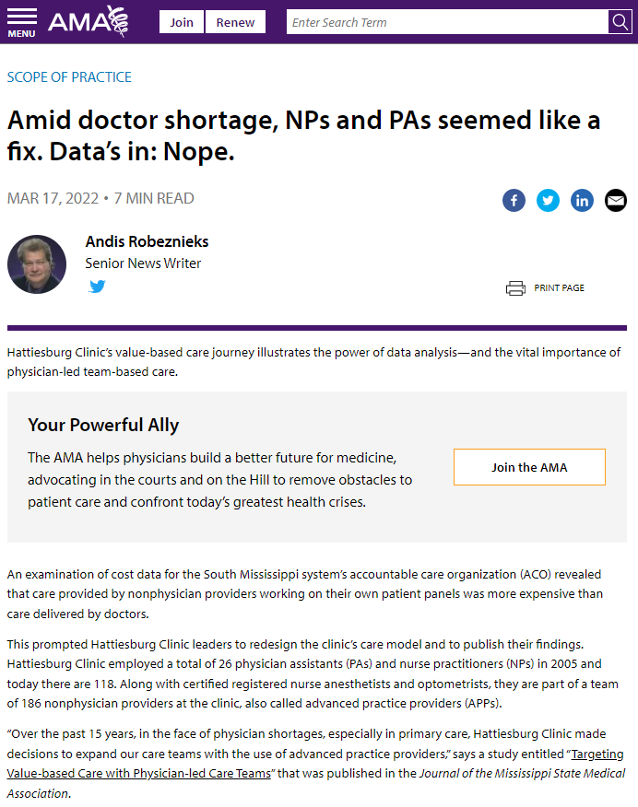
Importance of Physician-led Care Team
Claims, quality, and patient survey data from 2017-2019 Medicare ACO
Over 33,000 unique beneficiaries (non-ESRD, non-institutionalized)
Over 200,000 patient survey responses from Press Ganey

Slide 32

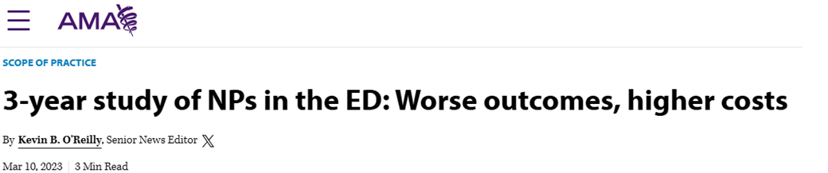
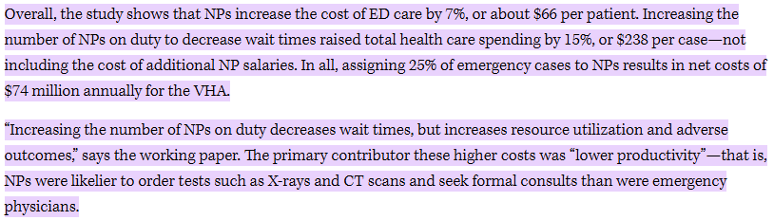
Stanford University study in Veterans Health Administration:
Unsupervised NPs increased cost of ED care by 7%
NPs increased the length of stay in the ED by 11%
NPs were associated with worse health outcomes, including a 20% increase in 30-day preventable hospitalizations

Slide 33

